Slide 1
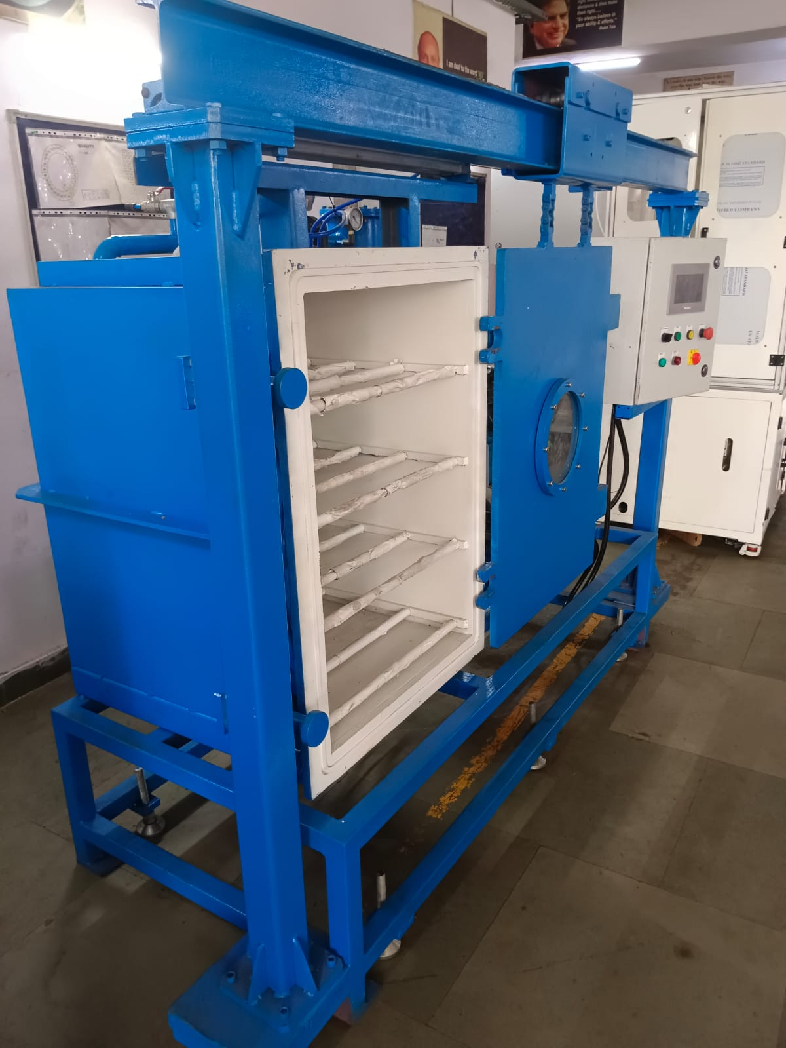
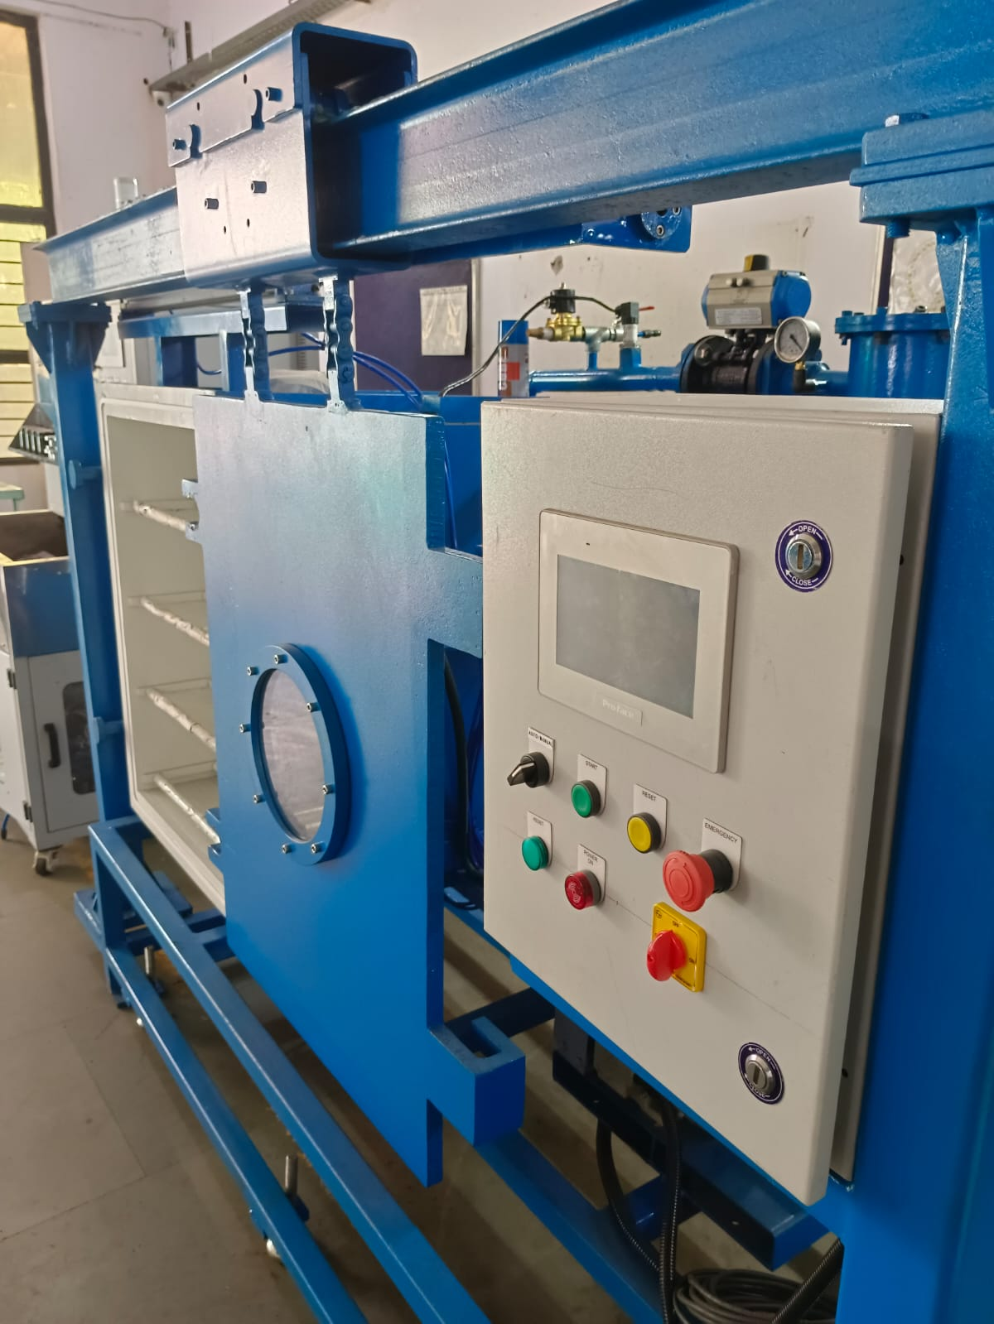
Automatic Vacuum Chamber

Slide 2
Automatic Vacuum Chamber – Technical Specification
General Details:
Type | Automatic Vacuum Chamber
Chamber Shape | Cylindrical / Rectangular (as per requirement)
Chamber Material | Stainless Steel SS304 / SS316L
Internal Volume | Customizable (e.g., 50 L / 100 L / 500 L etc.)
Chamber Door | Hinged or lift-type with silicone gasket for vacuum sealing
Window | Toughened glass / Polycarbonate (optional, for observation)
Vacuum Performance:
Ultimate Vacuum | Up to 1 x 10⁻³ mbar (0.001 mbar)
Pump Type | Rotary vane / Dry scroll / Roots blower with backing pump
Pump Down Time | < 15 minutes to 1 mbar (depends on chamber size & pump)
Leak Rate | < 1 x 10⁻⁵ mbar·L/sec
Automation & Controls:
Control System | PLC-based control panel with HMI touch interface
Vacuum Level Control | Auto with PID controller
Cycle Programming | Custom vacuum hold / vent cycles

Slide 3
Data Logging | Pressure vs time, cycle reports (USB or Ethernet)
Construction & Components:
Gaskets | Silicone / Viton / Neoprene
Feedthroughs | Electrical, thermocouple, gas inlets, as required
Cooling Jacket | Optional (for temperature control)
Vacuum Gauge | Pirani / Capacitive / Thermocouple type
Vent Valve | Solenoid operated, filtered air/nitrogen inlet
Power & Utilities
Power Supply: 230V/50Hz or 415V/3Ph/50Hz
Power Consumption: Depends on pump and automation (e.g., 1–5 kW)
Compressed Air: Required for pneumatic valves (optional)
Safety Features
Overpressure relief valve
Emergency stop switch
Vacuum interlock for door opening
Chamber over-temp / over-pressure alarm (if applicable

Slide 4
Optional Add-ons
Heating system (IR or electric band heaters)
Cooling system (water-cooled baseplate or coil)
Internal shelves or trays
Integration with process gas control system
Remote monitoring capability

